Slide 1
Stereo visual odometry

Slide 2
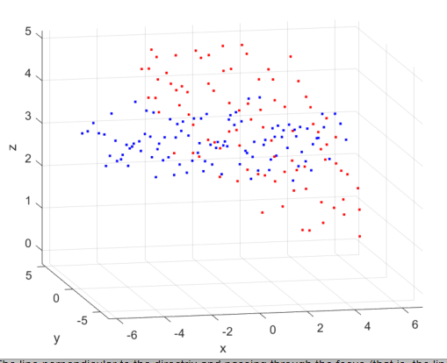
Motion estimation
Data set with know transformation

Slide 3
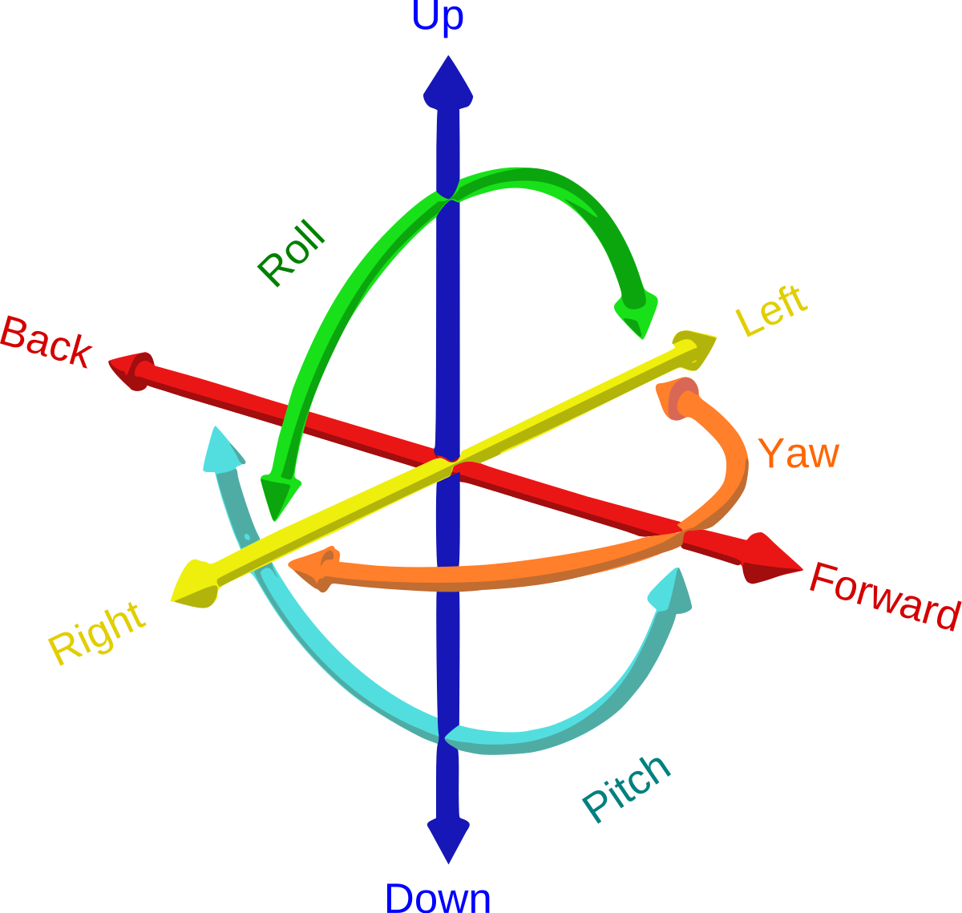
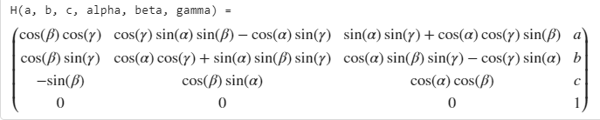
Homogenies transformation estimation
6 degrees of freedom

Slide 4
algorithmic
- Tries an increment on each DOF in both positive and negative direction
- Calculate error, sum of absolutte differences
- keeps the increment which impact the error the most.
- Repet

Slide 5
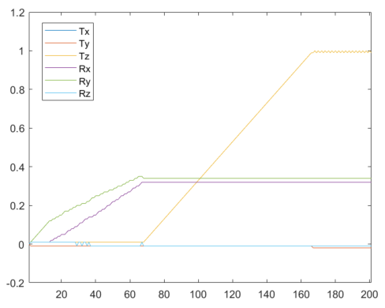
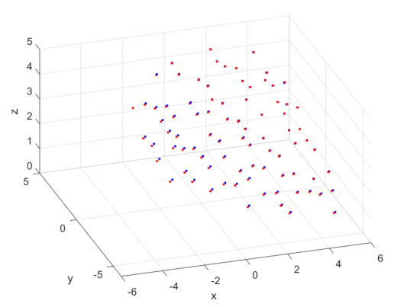

Slide 6
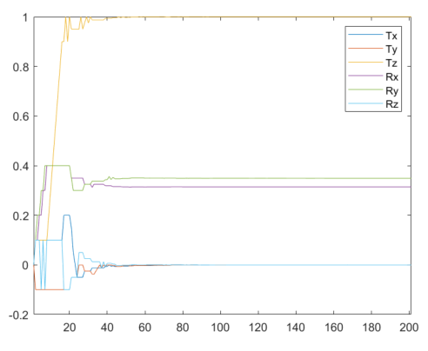
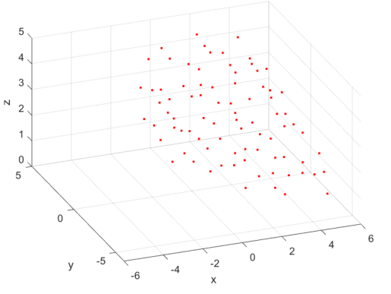
Start increment is big
If error==stationary, set increment to half

Slide 7
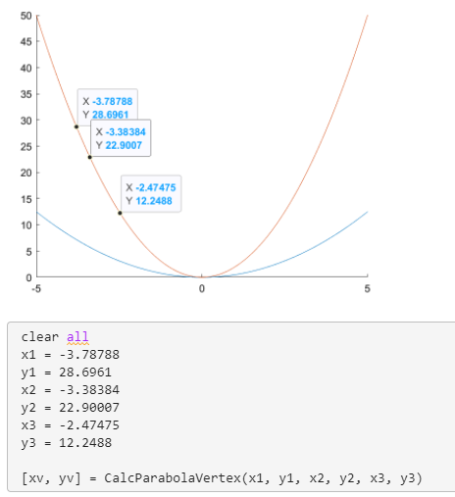

Next
Optimize with parabola
Error handeling

Slide 8
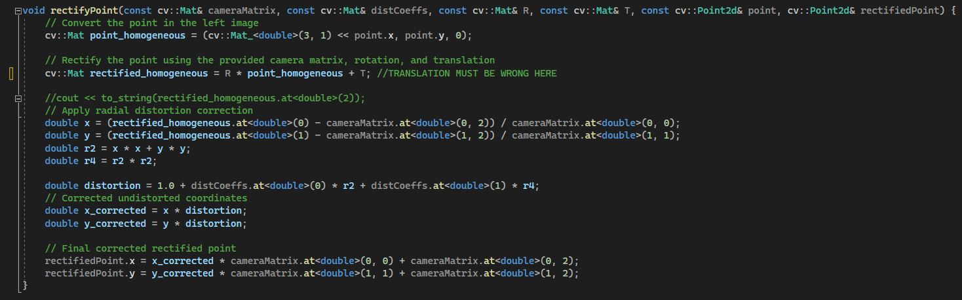
Stereo matching

Slide 9
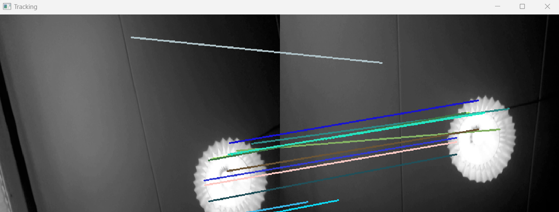
Feature matching with SAD
General trend is good

Slide 10
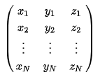

Kabsch algorithm
When 2D-points have been found, stereo matching is used to find the 3D-points
Point-set registration: Kabsch
(Copy-paste from Wikipedia)
Point set:
Removing offsets

Slide 11

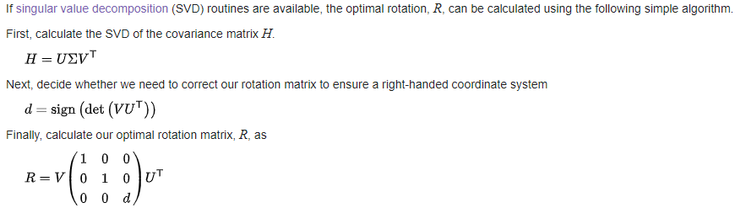
Kabsch algorithm

Slide 12


Kabsch algorithm
Testing: Making a wavy surface and applying a known rotation transformation about the x-axis
First test was done in MATLAB. X-axis rotation:
→

Slide 13
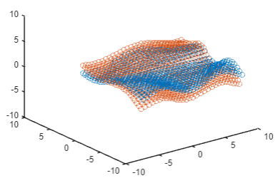

Kabsch algorithm

Slide 14

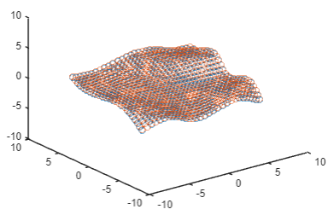
Kabsch algorithm
Input
Output

Slide 15
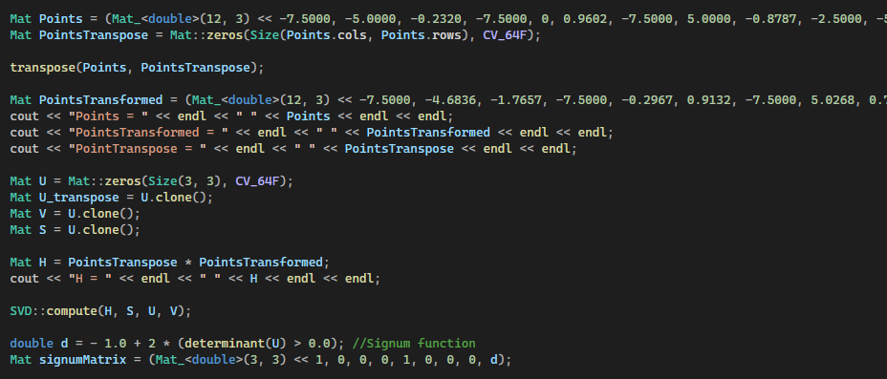



Kabsch algorithm
Also works in C++

